Slide 1
ClassMate (CAS Application)
South Software Solutions
Aryaman Chhikara, Austin Odom, Bharat Verma, Chayton Morris, Daivik Singla, Ethan Rice, Joseph Gray, Julia Woodruff, Manisha Devi, Rachel Honeycutt, Rajveer Singh, Shivam Sharma, Thomas Johnson, Victor Kumar, and Zachary Handel

Slide 2
CM/LEAD TEAM
Aryaman Chhikara, Austin Odom, Ethan Rice, Joseph Gray, and Zachary Handel

Slide 3
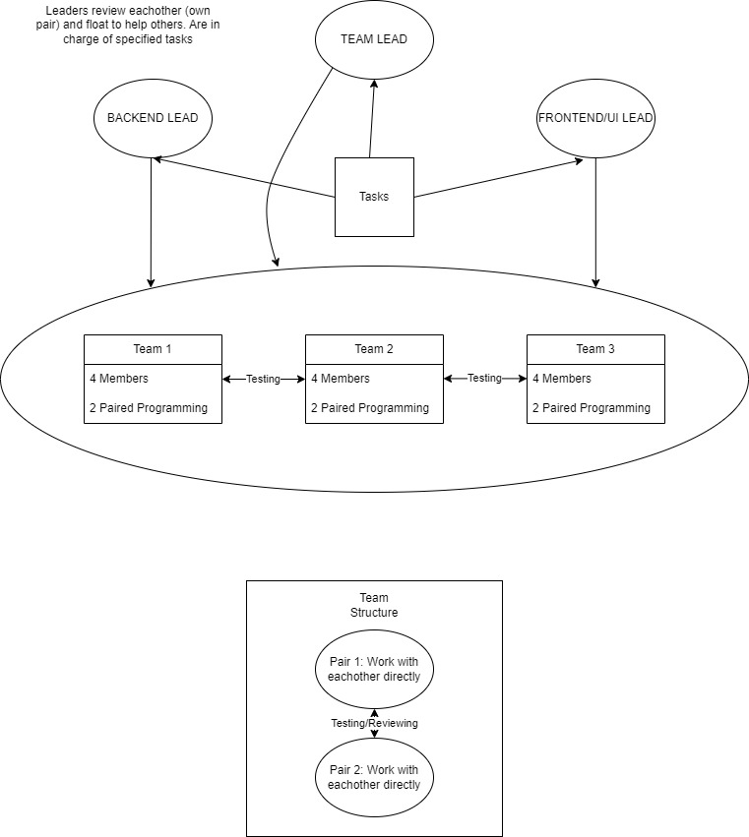
Process Model - Zachary Handel
Agile Approach
3 agile teams of 4 people
Paired programming
Status and standup meetings
Agile development

Slide 4
Tools - Zachary Handel
Communication: Started with Slack then transferred to Discord
Issue Tracking: Gitea
Version Control: Git
Development Language: Wt (Witty C++ Web Toolkit)
Debugging: GDB

Slide 5
CM Plan - Joseph Gray
Our CM Plan flows as follows:
Tasks were created by leadership team in a manner that would allow for easy distribution.
Tasks were assigned and then worked on by team members who were confident on the subject or were randomly selected.
Upon completion, all tasks needed to pass through 2 peer reviews to ensure functionality and quality.
Leadership team conducted reviews on tasks.
Completed and reviewed tasks are integrated and merged with the main project repository systematically, maintaining consistency and integrity across the project’s lifecycle.

Slide 6
Requirements Traceability Matrix - Joseph Gray
Requirement | Component/Data Structure
Bulk On-boarding of students by faculty | bulkOnBoardView
Temporary Password upon Initiation for students
Student-Centered Attendance Tracking | studentCourseView, recordAttendanceView
Attendance Evaluation by Faculty | attendanceManagementView
Classroom Management by Faculty | courseManagementView
Student Information Access | studentDash, studentCourseView,
Password Reset Functionality | forgotPassword
Admin Management of accounts and courses | adminDashboardView, accountManagementView, courseManagementView2

Slide 7
Requirements Traceability Matrix (cont.)
Requirement | Component/Data Structure
Display Attendance Code for Classes
Record Attendance with Code | recordAttendanceView
View/Print Attendance Reports (Individual/Classroom)
Admin Purge of Expired Courses and Attendance Records | adminDashboardView, accountManagementView, courseManagementView2
Register Faculty and Admin Accounts | addFacultyView
Edit/Delete User Accounts and Course Information | accountManagementView, courseManagementView2
Student Attendance Record Management (Add/Edit/Delete) | modifyStudentListView, attendanceManagementView
Automated Email Notifications for Attendance and Account Actions

Slide 8
SQA Plan - Ethan Rice
Our SQA Plan adhered to the following format:
As a task is described/developed, it is up to them to ensure their code quality.
After they post their description/create a PR for their code, first another sub-team member should review the code. (Subbed in CM/Lead sometimes)
Then, a CM/Lead member will review the code.
If both are approvals, then one of the mergers can merge the code into main.
If there is not two approvals, at least one of the reviews should say why the code/description does not pass and fixes must be made. Then, repeat from the top.

Slide 9
Individual Contributions - CM/Lead Team

Slide 10
Ethan - Leadership Team
My Role
Acted as Scrum master, keeping the flow of meetings quick and on topic.
Acted as a sort of backend lead, helping a lot with initial data modeling.
My Contributions
Helped with SRS, CM, SQA, and SDD documents.
Helped with modeling tasks on both data and class modeling.
Created initial path navigation, and laid the groundwork for others to be added.
Implemented bulkOnBoardView and addStudentView.
Reviewed and tested many task descriptions/user stories and implementations.
Lessons Learned
Project Management is hard, especially with everyone having other classes.
C++ is not a fun web language.

Slide 11
Zachary - Leadership Team
My Role
Team Lead and CM Member
My Contributions
Monitored processes within teams
Provided solutions to many team processes
Organized team meetings
Provided code reviews
Developed models and DB
Did some view development
Lessons Learned
Be able to conform to a large variety of skill sets within teams
Always be transparent within communication
Software engineering requires persistence

Slide 12
Joseph - Leadership Team and Team 1

Slide 13
MY ROLE
My role on the leadership team was to ensure notes were taken during meetings, review/test PR’s in gitea, work closely with team 1 to ensure that all tasks were divided properly, and I was responsible for several sections in our SDL documentation.

Slide 14
My contributions
I worked in every document that is in the SDL: SDD (sections 7, 2, 3), CMP (section 2), SRS (Some of the use case diagrams, section 2.4).
Made adjustments as needed
I divided up work for team 1 as well as working alongside them throughout the development process.
Developed views: Admin Dashboard, Course Management, and Account Management views.
Assisted in reviewing and testing PRs (providing feedback where needed).
Took notes during meetings until notes template was put into place and streamlined documentation.
Reviewed any team specific work upon request and acted as a resource when needed.
Communicated with leadership in regards to development, organization, and any other ideas.

Slide 15
Joseph - Lessons Learned
Time management; be more realistic
Underestimating tools
Communication is key

Slide 16
Aryaman - Change Management Team and Team 1

Slide 17
My Role
As a member in Change Management Team, I was responsible for providing Reviews on open PR’s, testing the views that were in build and creating the Change Management Plan and I was also involved in the development of the Software Design Document and SRS document.
Aryaman Chhikara

Slide 18
My contributions
I contributed throughout the development cycle.
I was responsible for Creating the Section 1 of Change Management Plan which was the Introduction.
Tools I used to create that were Overleaf and Latek.
I also contributed in reviewing the and updating the SRS Document where I divided the work among the teams members of Team 1.
Tools used were overleaf and LATEK
My contribution in the SDD was to Create Wireframes/views along with Team 1 members where I built the Wireframe for Account settings page and Bulk-on-board page
Tool used for building wireframes - Canva.
I was responsible for the Development of the teacher Dashboard View.
Tools used for building the Teacher Dashboard view - C++, wt library for
Reviewing and Testing:
I was involved in Unit - Testing the models developed by the CAS team. My testing consists of ensuring the model is working according to acceptance criteria.
Giving Approvals to PR’s that were created once the view passes the acceptance criteria
Aryaman Chhikara

Slide 19
Lessons Learned
Time Management is Key - This project made me realise how one person’s inefficiency can cause a huge loss for the whole team and you never want to be the one, so always do your work ahead of time so that there is ample time to find errors and fix them
How the SDLC works - Its mostly documentation which helps in efficient and comfortable development of the project.
Learning how version control tools work and how important they are - They allow for a great collaborative development environment and are crucial to large scale development
Aryaman Chhikara

Slide 20
Lessons Learned

Slide 21
AGILE TEAM 1
Aryaman Chhikara, Julia Woodruff, Bharat Verma, Chayton Morris

Slide 22
Individual Contributions - Julia
Completed section 2.2 of the SRS (Product Features)
Completed section 6.1 of the SDD (Overview of the User Interface)
Created wireframes for the following:
Course management view for teachers
Course management view for administrators
Teacher view of students
Student modification view for teachers
Account and attendance management view for administrators
Peer reviewed Chayton’s wireframes
Created the login view
wrote the user story, acceptance criteria, and test scenarios as well as the code for it

Slide 23
Lessons Learned - Julia
Communication is so important especially in a team this size
Learned how to use Witty and Gitea
Time management is necessary – getting things done ahead of time

Slide 24
Software Architecture
ClassMate is designed to help schools manage class attendance easily.
It works through a website that students, teachers, and school admins can use.
Different User access levels for Students, Teachers and Admins:
Students view their attendance and manage their profiles.
Teachers handle class details and attendance records.
Admins manage the system and user accounts.
Functionality:
The software allows teachers to upload student details and manage attendance online.
Students can check in to classes digitally and view their attendance history.
Admins oversee the entire system, ensuring everything runs smoothly.
The website is easy to use, designed for quick navigation.
Each user type sees only the features they need, making it simple, efficient and secured.

Slide 25
Individual Contributions - Bharat
SRS
Completed Section 2.5 (Design and Implementation Constraints)
Review and Correction of Sections 2.3.1, 2.3.2 and 2.4
Modeling
Created wireframes for: -
Login View
Forgot Password View
Student Dashboard View
Faculty Dashboard View
Admin Dashboard View
Created User Stories, Acceptance Criteria, Test Scenarios And Implementation For: -
Universal Header And Footer
Add Faculty View
View Student View
Provided comments on PR’s

Slide 26
Lessons Learned - Bharat
Document Strategically, Develop Efficiently: Balance between thorough documentation and proactive coding is key
Anticipate to Mitigate: Proactively addressing issues prevents minor problems from becoming project roadblocks.
Harness Technology for Teamwork
Prioritize Wisely, Execute Effectively

Slide 27
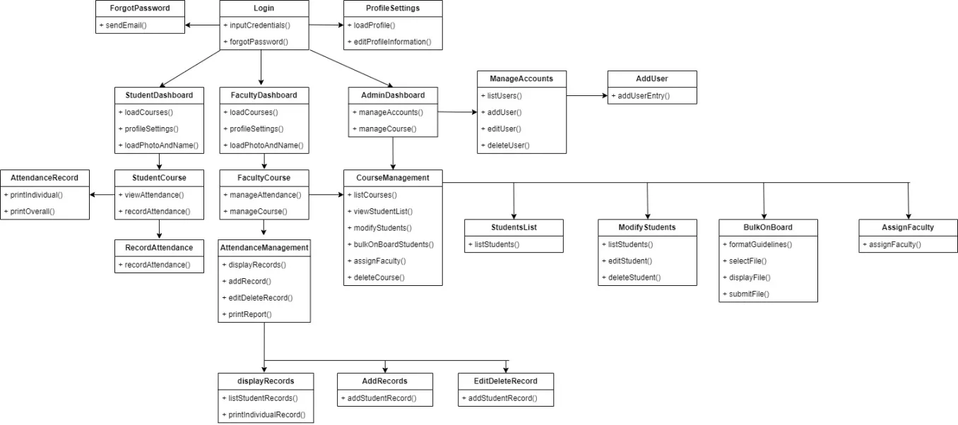
View Architecture
Notes:
Views were organized into separate pages.
Buttons were implemented using different mechanisms for event handling and page navigation.

Slide 28
Individual Contributions - Chayton
SRS
Completed Section 4.1(Applicable Standards)
Review and Correction of Sections 1.1, 1.2, 1.3, and 1.4
Modeling
Created view wireframes for:
Attendance Recording
Attendance Management
Attendance Record Display
Add/Edit/Record Display
Created User Stories, Acceptance Criteria, and Test Scenarios for Student Dashboard View
Created the Student Dashboard View
Provided approval/comments on PR’s

Slide 29
Lessons Learned - Chayton
Importance of effective communication, collaboration, and how to effectively solve conflicts.
Learned all the aspects of software development/SDLC.
Gained knowledge of Wt.

Slide 30
AGILE TEAM 2
Daivik Singla, Rachael Honeycutt, Shivam Sharma, Thomas Johnson

Slide 31
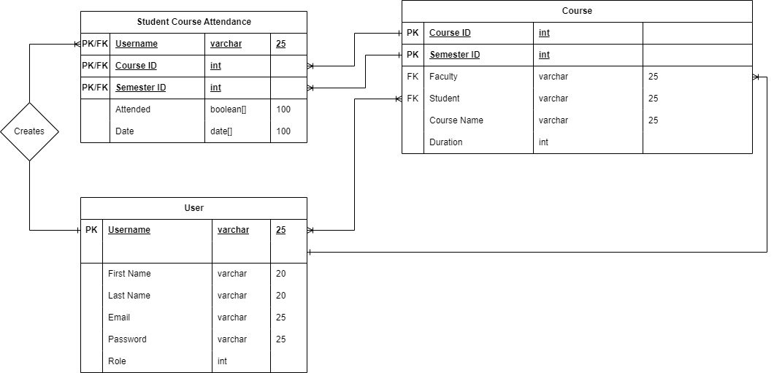
Model Architecture
Notes:
If we had more time, this would not be the final version.
The data models include three tables with a generic User for student, faculty, and admin.
Student Course Attendance is a record of attendance for one student in a given class. A student may have multiple classes and a course has multiple students.
The database is created by the main casApp class and referenced by every view that uses it. The database is the center core of the design.

Slide 32
Individual Contributions - Daivik
SRS
User Classes and Characteristics
Use Cases
View Individual Student Attendance Report by Date-(VSRD)
Print Individual Student Attendance Report by Date-(PSRD)
View Individual Student’s Overall Attendance Report-(VSOR)
Print Individual Student’s Overall Attendance Report-(PSOR)
View Overall Course Attendance Report-(VOCR)
SDD
Data Modeling & Data Dictionary Tables
Student Course Attendance
Reviews
Forgot Password View (issue #32 on gitea)
Add Record View (issue #47 on gitea)

Slide 33
Individual Contributions - Rachel
SRS
Project Scope & Product Features (section 1.4)
Use Cases
Edit Individual Attendance Record
Admin Register Account
View Active List of Course for School
View Expired List of Courses for School
View Courses by Teacher
Corrections
SDD
ER Data Models & Data Dictionary Tables
Admin
Faculty
Attendance Management View

Slide 34
Individual Contributions - Shivam
SRS
Performance Requirements (non-functional requirements) (section 3.1)
Use Cases
Print Overall Course Attendance Report (POCR)
Remove Student From a Course (RSFC)
Edit Individual Student’s Profile (ESP)
Add Individual Attendance Record (AAR)
Deletion Individual Attendance Record (DAR)
SDD
(ER) Data Models & Data Dictionary Tables
Student (Email, Username ,Password, Foreign Key to Student Course,First Name, Last Name)
Profile Setting View ( Gitea #issue 33)

Slide 35
Individual Contributions - Thomas
SRS
Use Cases
Bulk Upload Students
Faculty Observe Course
Display Attendance Code
View Course Attendance Report
Print Course Attendance Report
SDD
Data Model
Course
Compilation
Display Records View
Database integration with views

Slide 36
Lessons Learned
Wt::Dbo is difficult to use and learn, and doesn’t allow easy querying. Other libraries should be explored before attempting to use again.
User experience and usability are improved when the application's various views and pages have a consistent user interface (UI) design. I learned the value of consistent styling, layout, and interaction patterns during the implementation of the forgot password and add record views. This will help to guarantee that users can navigate and interact with the application with ease.
Importance of testing:- While Wt is a difficult library to work with, it is easy to lose control of the code's flow. Aside from unit testing, I discovered how important "team-based testing" is when working on larger projects or in a less specialized language.

Slide 37
AGILE TEAM 3
Manisha Devi, Rajveer Singh, Victor Kumar, Austin Odom

Slide 38
Overall Testing Approach
Types of testing to be used
- Ad-hoc Testing - Testers will use their experience, intuition, and creativity to identify
defects and issues.
- Unit Testing - Testers will focus on individual components of the system.
- Usability Testing - Testers will ensure that all user interfaces are intuitive and do not cause unnecessary confusion. Used when any new functionality is added.
- Integration Testing - Leadership perform tests to ensure that different components
Of the software work together.

Slide 39
Testing Process and Result
A task description (user story, acceptance criteria, and test scenario) will be developed for each task.
The Individual will test out their code to verify that the added features are implemented/working correctly.
A peer review will happen immediately after a sub-team member completes their first iteration of coding, and will happen by one of their fellow members.
A PR review will happen after a peer review gets accepted, and will be verified by all members of the sub-team as working. During the PR review .h and .cpp files will be downloaded from the files changed section of the PR and each feature will be tested extensively using the task description to ensure the features are functioning as they should be and nothing is being added into production that would damage functionality or quality.
A PR approval will then happen when a team lead accepts the PR, after testing the iteration themselves.
Two PR approvals will be required before merging the code onto the main branch.
If there’s not two approvals or fails to pass any test, feedback is given at each step stating why it didn’t pass and the process will start over again.
All test results are stored in the comments of the issue found in gitea.

Slide 40
Integration Testing
Collaborative Testing: Sub-teams are responsible for integrating and testing their sections of code. This includes creating detailed user stories, acceptance criteria, and test scenarios to ensure thorough coverage.
Incremental Integration: We adopt both top-down and bottom-up approaches for integrating modules incrementally. This method helps isolate faults and verify the functional interactions between different system parts.
Rigorous Review Cycle: After completing initial coding and testing, each sub-team undergoes a peer review. Successful reviews lead to pull requests (PRs), which are extensively tested by other team members to ensure robust integration.
Dual PR Approvals: Two approvals from team leads are required for all PRs, enhancing the reliability of our integrated system. This dual-check system ensures that every feature adheres to our high-quality standards before being merged.
Documentation and Feedback: All integration test results are meticulously recorded in our Gitea repository within the comments of the related issues. This not only provides a clear audit trail but also facilitates transparent feedback mechanisms. If integration tests fail to meet standards, the process is revisited to make necessary improvements

Slide 41
Individual Contributions - Austin
SRS
Developed Use Cases
Safety Requirements
Security Requirements
CM Plan
Training
SQA Plan
Documentation and Reporting
Reporting Process
Issue and Error Reporting
SDD
Component Design
Contributed to Class Modeling
Course Management View for Faculty

Slide 42
Lessons Learned - Austin
Expanded my knowledge of software development processes, and documentation.
Learned the pros and cons of working with a large team.
Learned how crucial communication is to the success of the team.
Became more familiar with Wt.
Expanded my knowledge of software architecture.

Slide 43
Individual Contributions - Victor
SRS
Section 2.4 (Operating Environment)
SQA Plan
Software Overview
Description
Features and Functionality
Contributed to Class Modeling
Password Reset
Admin Management
Classroom Management
Edit Individual Attendance Record
Admin Register Account
View Active List of Course for School
Provided approval for PR
Student List View for Faculty
Created user story, acceptance criteria, test scenarios, and code.

Slide 44
Lessons Learned - Victor
Gained knowledge in Wt and Gitea.
How crucial communication is for a team this big.
Importance of testing.
The importance of time management.

Slide 45
Individual Contribution - Manisha
SRS
Section 3.4 (Software Quality Attributes)
SQA Plan
Introduction
Purpose
Definition
Contributed to Class Modeling
Student -Centered Attendance
Attendance Evaluation
Password Reset
Student-Centered Attendance
Created User Stories, Acceptance Criteria, and Test Scenarios for Student Individual Course
Student Individual Course View ( issue #34 on gitea)
Admin Manage Accounts View ( issue #37 on gitea)

Slide 46
Lessons Learned - Manisha
Learned about wt and gitea during the project
Acknowledged that wt is complicated, especially when using it.
Additionally, prioritizing time management was crucial, allowing activities to be done efficiently and enabling smother project process

Slide 47
Individual Contributions - Rajveer
SRS
SRS 1.4
Classroom Management
Student Information Access
SRS 2.2
Student Information Access
Attendance Evaluation
SRS 2.3.2
VSRD through RSFC
Contributed to Class Modeling
Faculty Individual Course View
Created user story, acceptance criteria, test scenarios, and code.

Slide 48
Lessons Learned - Rajveer
Software Architecture: Deepened knowledge in software architecture, focusing on choosing appropriate technologies for project needs.
Wt Proficiency: Advanced skills in using Wt for responsive web design and dynamic user interactions.
Development Processes: Enhanced understanding of the full software lifecycle and the critical role of thorough documentation.
Communication: Improved communication strategies to ensure clarity and continuous improvement within the team.
Team Dynamics: Learned to work in large team, emphasizing conflict resolution and effective coordination.

Slide 49
SOFTWARE DEMO
Performed By: Zachary Handel
Backup Video: https://youtu.be/FZ1xggSmtp0

Slide 50
FINAL RECAP
Zachary Handel
Thank you!

